Slide 1
JS RUNTIME
Team Name: skcoder
Team leader: Sanjai Kumar R
Date: 7/9/2024

Slide 2
The Problem Statement
To implement a new function like console.warn() or console.error() in your runtime that formats the output differently (e.g., color-coding, adding timestamps etc).
To create a custom method, console.debug(), that logs messages only if a debug flag is set (environment variable or configuration file).

Slide 3
The Solutions
Has Implemented all the three methods mentioned in the task
Created methods with different colors and Timestamps
Code to git hub :

Slide 4
Methods – warn()
warn: (...args) => {
const time = getCurrentTime();
const message = argsToMessage(...args)
const logMessage = `\x1b[1;31m[${time}]] [Warning !!!]:\x1b[0m ${message}`;
core.print(`${logMessage}\n`,true);
},

Slide 5
Methods – error()
error: (...args) => {
const time = getCurrentTime();
const message = argsToMessage(...args)
const logMessage = `[-----ERROR----] \n Time: \x1b[1;33m[${time}]] :\x1b[0m ${message}`;
core.print(`${logMessage}\n`,true);
},

Slide 6
Methods – debug()
debug: (...args) => {
if(flag){
const time = getCurrentTime();
const message = argsToMessage(...args)
const logMessage = `\x1b[1;34m[ [==========DEBUG==============] ]]:x1b[0m] \n
Time: \x1b[1;33m[${time}]] :\x1b[0m ${message}
\n \x1b[1;34m[ [==========DEBUG==============] ]]:x1b[0m]`;
core.print(`${logMessage}\n`,true);
}
},

Slide 7
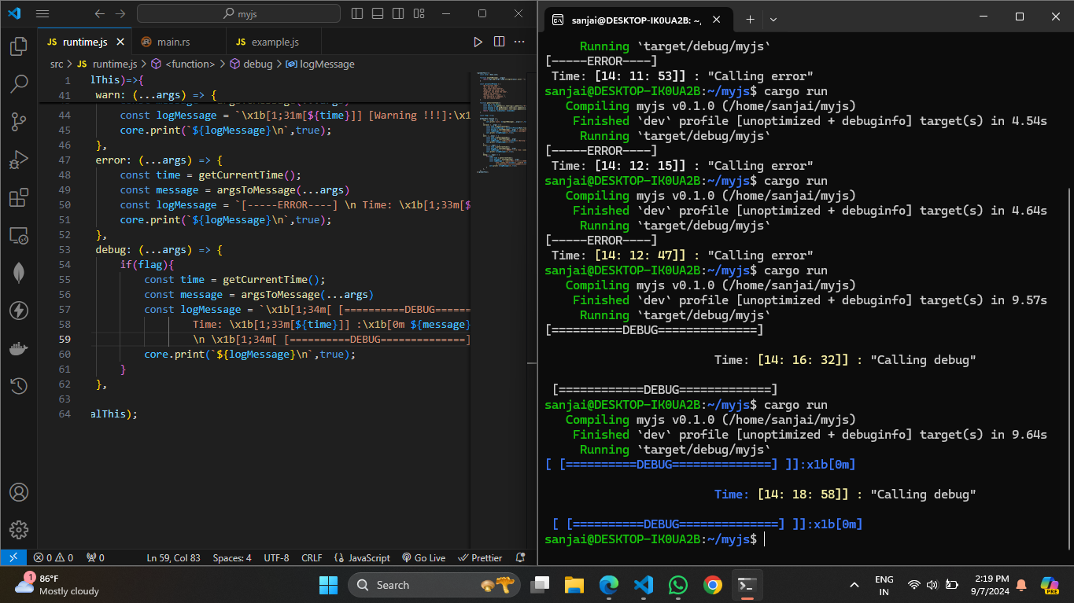
Outputs

Slide 8
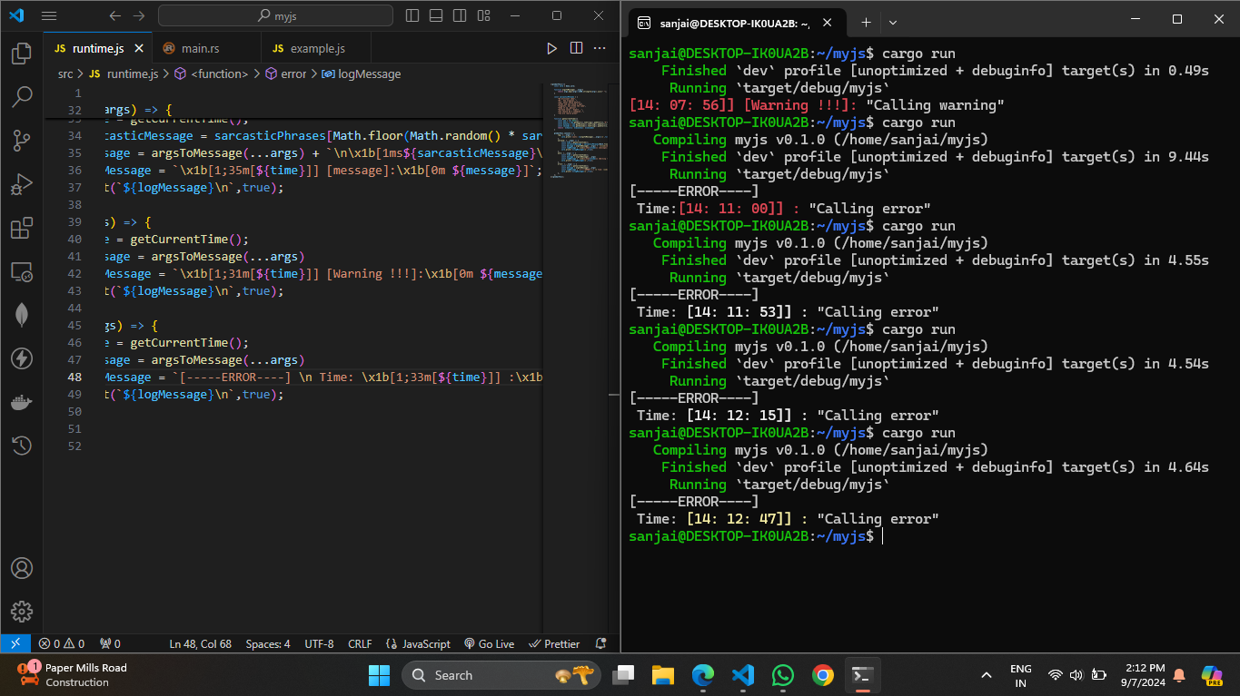
Outputs

Slide 9
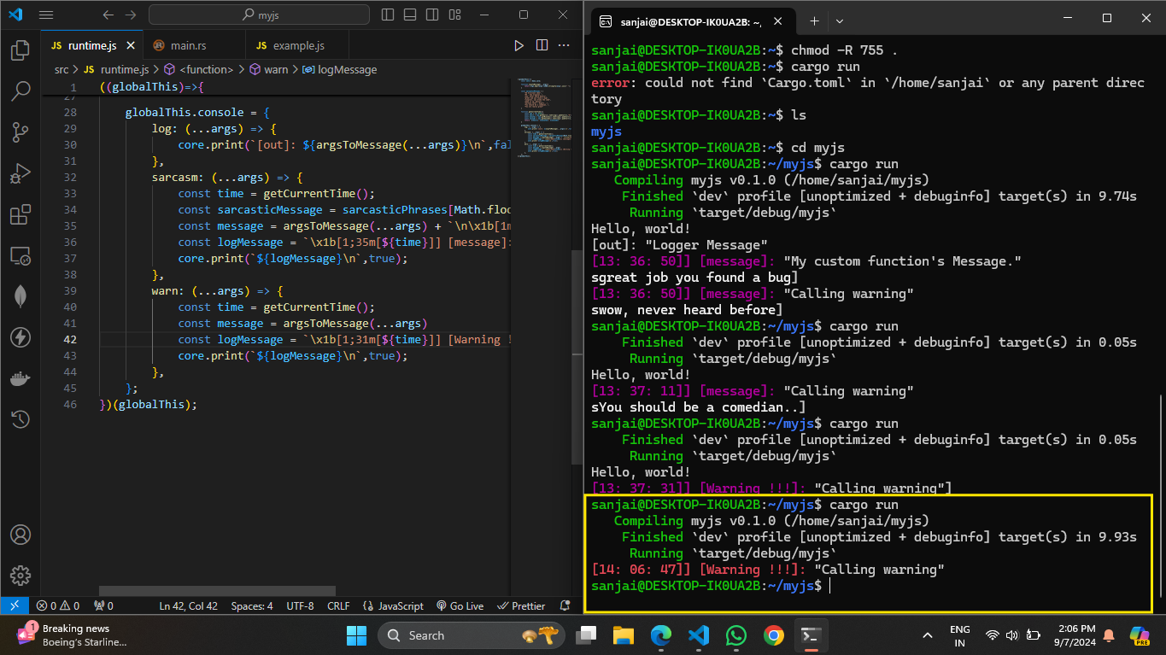
Outputs

Slide 10
Thankyou
Email : sanjaikumar451@gmail.co
Linkedin : (11) Sanjai Kumar Ravichandran | LinkedIn

